Slide 1

Open a Pizzeria in New York
Homero Welsh

Slide 2
Introducction
New York City's food culture includes an array of international cuisines influenced by the city's immigrant history. Central and Eastern European immigrants, especially Jewish immigrants from those regions, brought bagels, cheesecake, hot dogs, knishes, and delicatessens (or delis) to the city. Italian immigrants brought New York-style pizza and Italian cuisine into the city, while Jewish immigrants and Irish immigrants brought pastrami and corned beef, respectively. Chinese and other Asian restaurants, sandwich joints, trattorias, diners, and coffeehouses are ubiquitous throughout the city.

Slide 3
Bussines Problem
A client wants to open his business in Manhattan area, so I focus on that borough during my analysis. We define potential neighborhood based on the number of pizza places which are operating right in each neighborhood. Manhattan has full potential but also is a very challenging district to open a business because of high competition. A new pizza place should be open in an area that inadequate neighborhood in this way the resutaurant can attract more customers. Therefore, this analysis necessary to ensure that we have enough customers and that we are not so close to other sushi places.

Slide 4
Data Selection
To identify the characteristics of our competitors' venues in manhattan, we would first need to find out the number of pizza places in manhattan currently and their location.
We then used google map API to find their geographic coordinates based on their postal code addresses.
New york data luckily exists for free on the web. Feel free to try to find this dataset on your own, but here is the link to the dataset: https://geo.Nyu.Edu/catalog/nyu_2451_34572
I downloaded the files and placed it on the server
Also I took pizza places venues categories from foursquare 4bf58dd8d48988d1ca941735

Slide 5
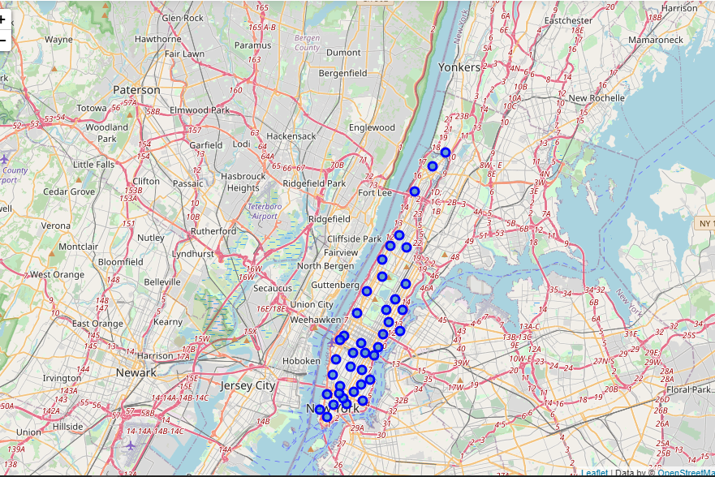
Methodology
I took neighborhood from wikipedia and put blue dots on New York map to see centers of neighborhoods. There are 40 neighborhoods in Manhattan

Slide 6
Methodology
Addresses are converted into their equivalent latitude and longitude values.
1
Foursquare API is used to explore neighborhoods in Manhattan, New York.
2
After that, explore function to get pizza places categories in each neighborhood.
3

Slide 7
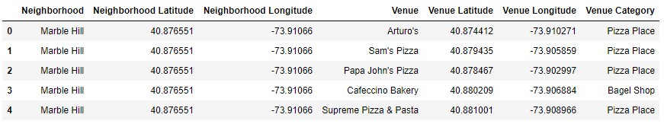
Methodology
Next, we also used Google Map API to find their geographic coordinates of the 5 locations shortlisted for pizza places:

Slide 8
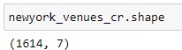
Methodology
Next, we also used Google Map API to find their geographic coordinates of the 5 locations shortlisted for pizza places:
In Manhattan, there is 1614 pizza places are currently operating.

Slide 9
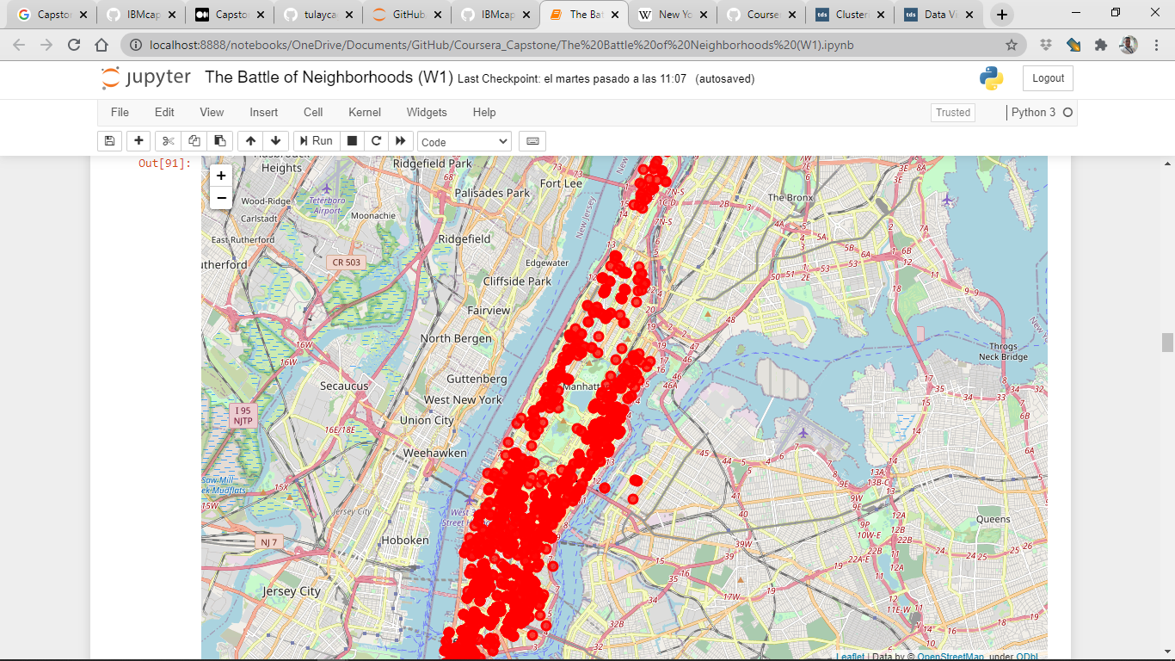
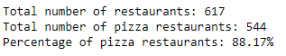
New York Pizza Places
Manhattan

Slide 10
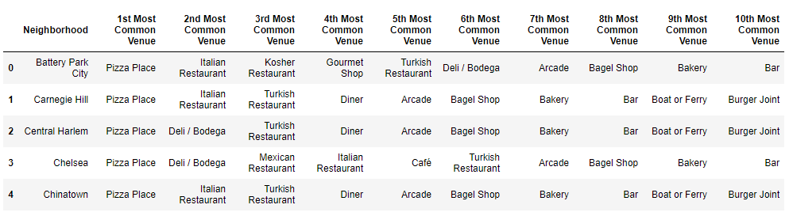
Then using this feature to group the neighborhoods into clusters K-means clustering algorithm will be use to complete this task. And also, the Folium library to visualize the neighborhoods in Manhattan and its emerging clusters.

Slide 11
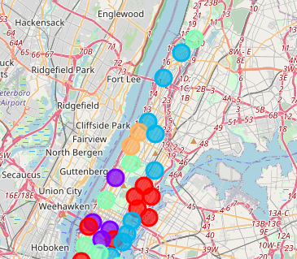
Clusters
Cluster 0: Red
Cluster 1: Purple
Cluster 2: Blue
Cluster 3: Light Green
Cluster 4: Orange

Slide 12
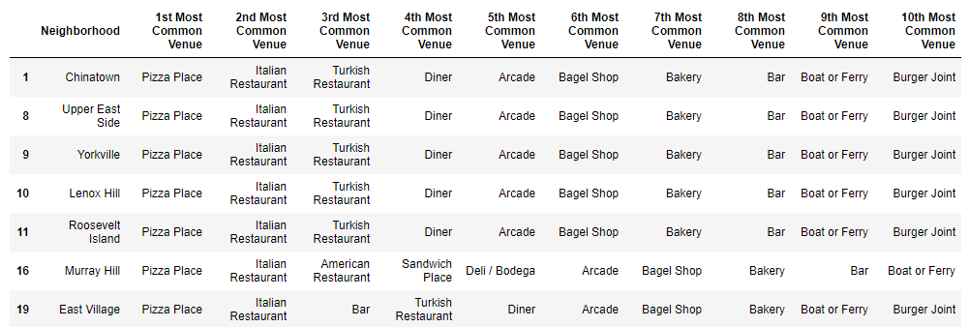
Cluster 0

Slide 13
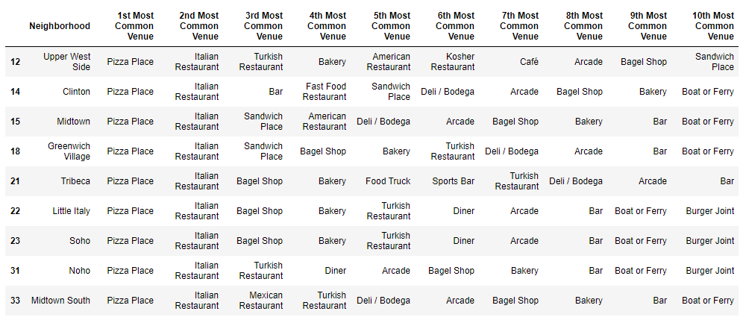
Cluster 1

Slide 14
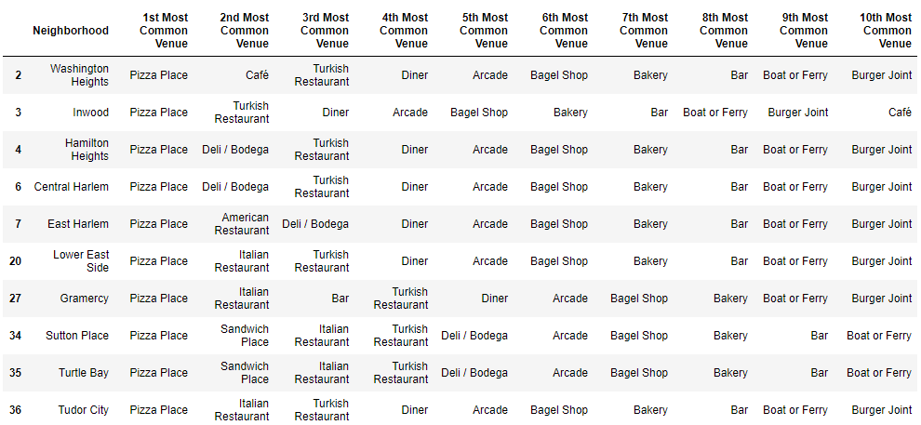
Cluster 2

Slide 15
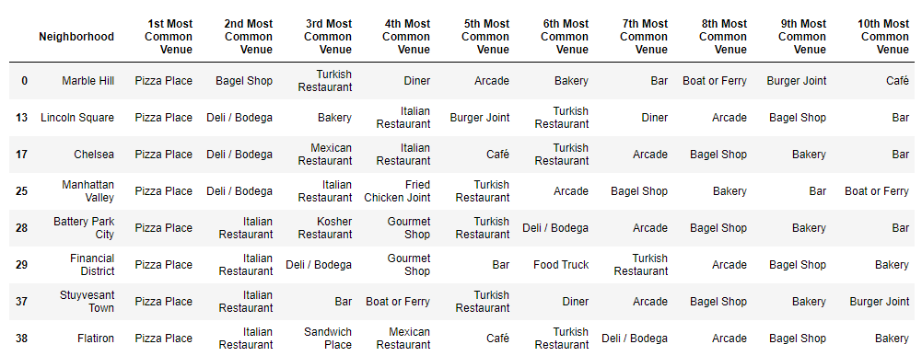
Cluster 3

Slide 16
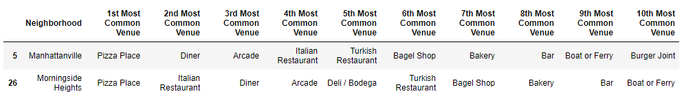
Cluster 4

Slide 17
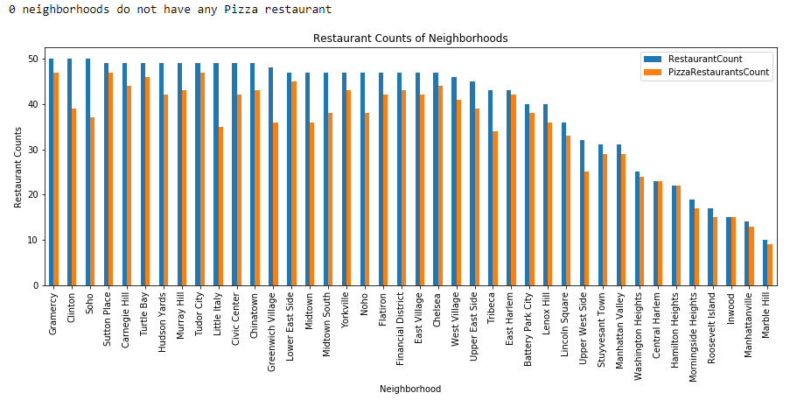

Slide 18
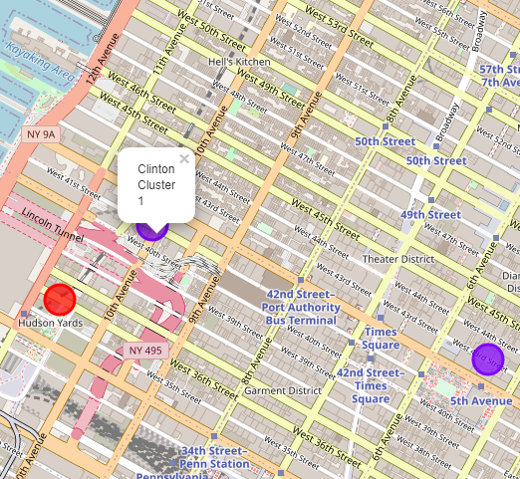
BEST PLACE
Cluster 0 and 1 especially likes Itallian tastes.
Between Hudson Yards (Cluster 0) and Clinton (Cluster 1) is the best area for a pizza place.

Slide 19
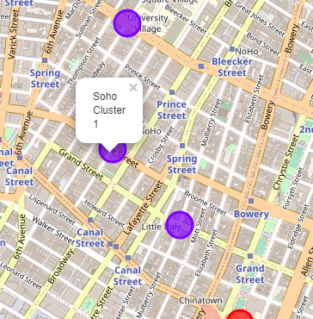
Opportunity Zone
Cluster 0 and 1 especially likes Itallian tastes.
We could have an opportunity there.

Slide 20
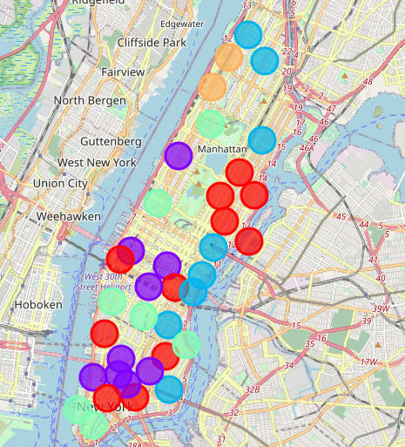
About Cluster 4
Cluster 4 (Morningside Heights) and (Manhattanville) It has fewer restaurants, but most of the restaurants are pizzerias.

Slide 21
Possible Neighborhoods to set up a pizza place
• Neighborhood : Hudson Yards , Cluster 0, population: 70,150
I choosed Hudson Yards as first choice , since the Neighborhood of this cluster love italian tastes, the population and overall we still having profit margin for pizza places about the comparation restaurant / pizzerias.
• Neighborhood : Clinton , Cluster 1, population: 45,884
I choosed Clinton , since the Neighborhood of this cluster love italian tastes, and overall we still having profit margin for pizza places about the comparation restaurant / pizzerias.
• Neighborhood : Soho , Cluster 1, population: 42,742
I choosed Soho , since the Neighborhood of this cluster, love italian tastes, and overall we still having profit margin for pizza places about the comparation restaurant / pizzerias.

